Slide 1


Certificate in
STEM Curriculum Development Programme
4th run
Contact person: A/P Teo Tang Wee
tangwee.teo@nie.edu.sg
© 2022 Nanyang Technological University, Singapore. All Rights Reserved.

Slide 2
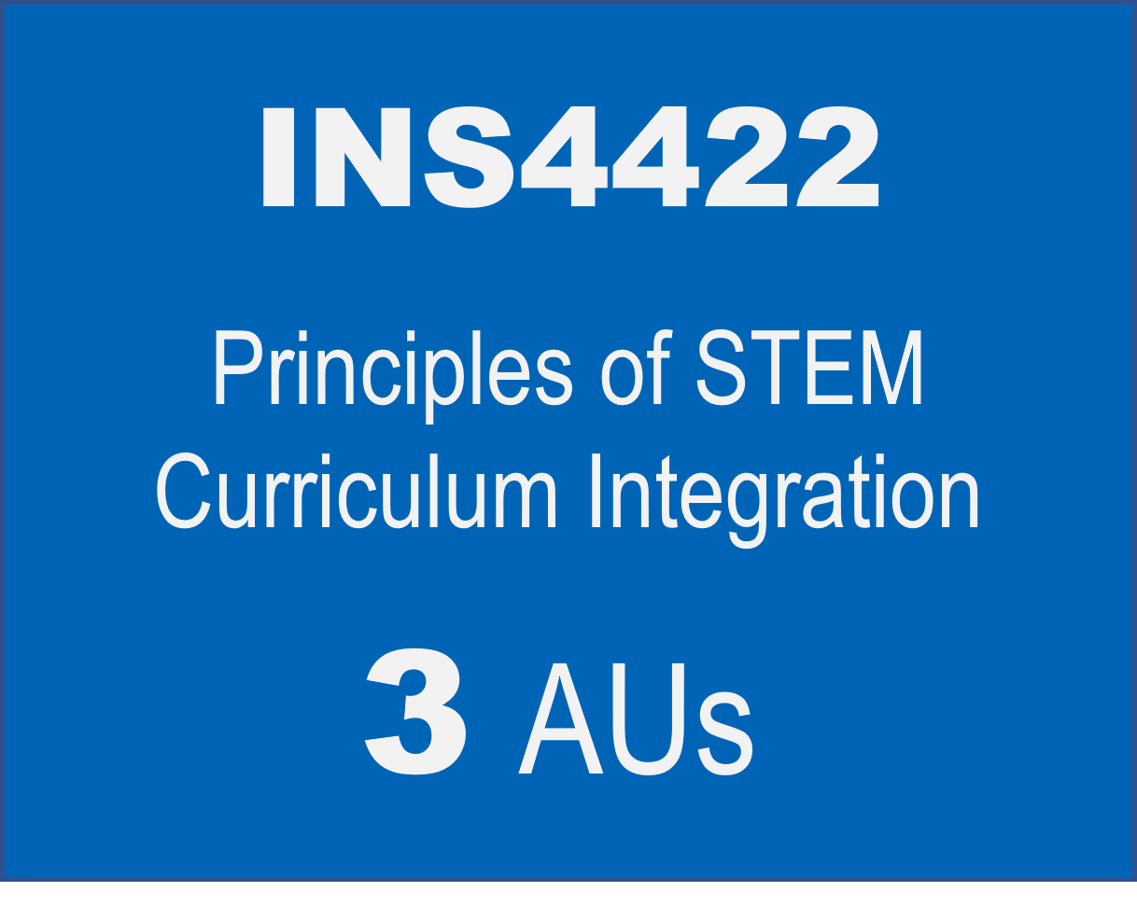
Structure
Certificate in
STEM Curriculum Development Programme
INS4423
INS4424
Approaches and Emerging Technologies in STEM Education
Designing an integrated STEM Education Portfolio
1
AUs
4
AUs
8 AUs

Slide 3
INS4422 Course Content
Module | Module Title | Online Asynchronous Week Beginning | Online Synchronous Week Beginning
1 | Origins of STEM Education | 8 April 2026 | 1 April 2026
2 | Successful STEM Education | 15 April 2026 | 22 April 2026
3 | STEM Education in Asia | 29 April 2026 | 6 May 2026
4 | The role of Science in STEM Education | 13 May 2026 | 20 May 2026
5 | Integrated STEM Framework | 27 May 2026 (Hari Raya Haji) | 3 June 2026
6 | MOE STEM Education for Singapore | 10 June 2026 | 24 June 2026
7 | Consolidation |  | 1 Jul 2026
 |  | 18 hours | 21 hours
Once a week and 3h per session. Dates are subjected to change in discussion with the course participants.

Slide 4
INS4423 Course Content
No. | Topic | Dates | Format
1 | Digital literacies – Halocode | 22 Jul 2026 | Face-to-Face @NIE, 3-6pm; 1h HW
2 | Digital literacies – Halocode | 29 Jul 2026 | Face-to-Face @NIE, 3-6pm; 2h HW
3 | Digital literacies – Halocode | 5 Aug 2026 | Face-to-Face @NIE, 3-6pm;
4 | Generative AI | 12 Aug 2026 | Face-to-Face @NIE, 3-6pm;
5 | Sports Science and Science of Learning | 19 Aug 2026 | Face-to-Face @NIE, 3-6pm;
6 | Sustainability and Urban farming | 26 Aug 2026 | Face-to-Face @NIE, 3-6pm;
7 | Sustainability and Urban farming | 2 Sep 2026 | Face-to-Face @NIE, 3-6pm;
8 | Asynchronous (self-paced learning) | 9 Sep 2026 | Asynchronous
9 | Sustainability - 3D printing | 16 Sep 2026 | Face-to-Face @NTU, 3-6pm
10 | Sustainability - 3D printing | 23 Sep 2026 | Face-to-Face @NTU, 3-6pm
11 | Sustainability - 3D printing | 30 Sep 2026 | Face-to-Face @NTU, 3-6pm
12 | Physic Demo Lab | 7 Oct 2026 | Face-to-Face @NIE, 3-6pm
13 | Emerging Technologies for Food Science | 14 Oct 2026 | Face-to-Face @NIE, 3-6pm
14 | Digital coding to create aesthetic designs | 21 Oct 2026 | Face-to-Face @NIE, 3-6pm
15 | Digital coding to create aesthetic designs | 28 Oct 2026 | Face-to-Face @NIE, 3-6pm
16 | AI in Education | 4 Nov 2026 | Face-to-Face @NIE, 3-6pm
17 | AI in Education | 11 Nov 2026 | Face-to-Face @NIE, 3-6pm
Topics and order are subjected to change

Slide 5
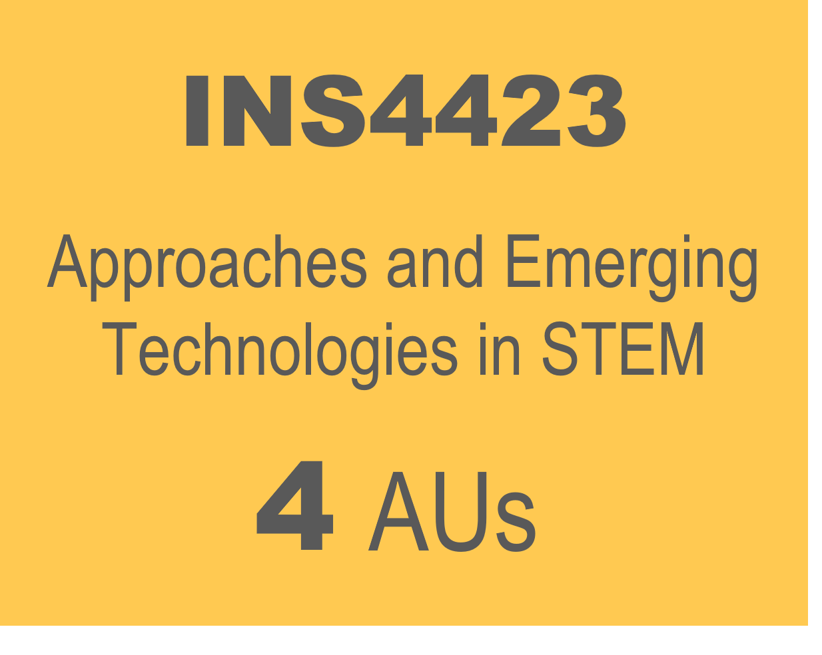
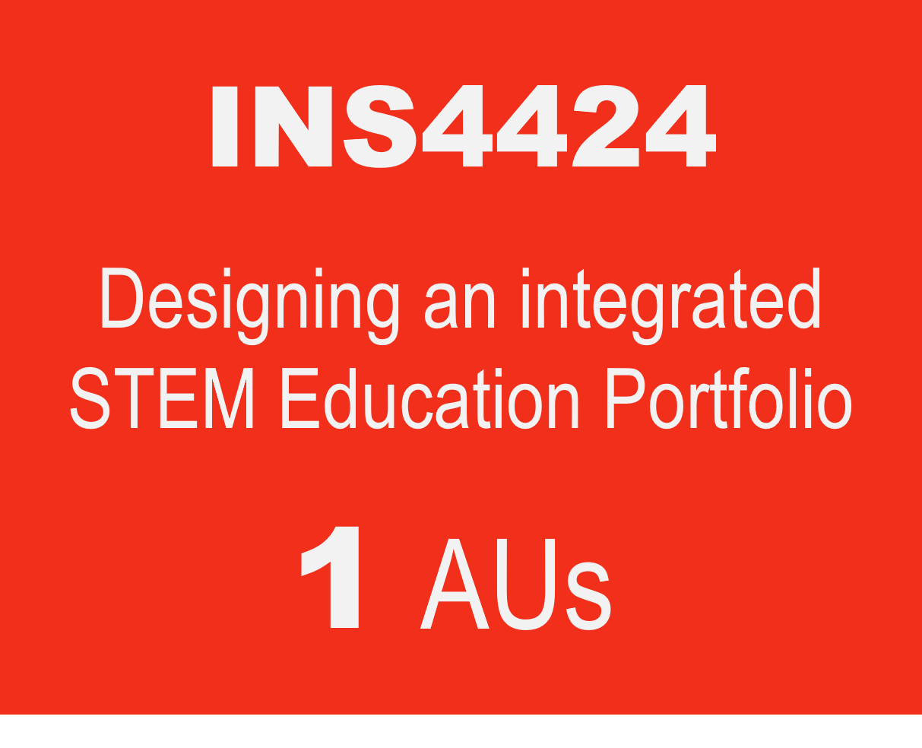
Illustration of Completion within 11 months
Year 2026
Year 2027
Q1 – Q2
Q3 – Q4
Q1 – Q2
Q3 – Q4
Apr - Jul
This 39h is 100% online. The content will be made available from April-Jul 2026
Jul - Nov
Jan - Feb
Q1: Jan-Mar; Q2: Apr-Jun; Q3: Jul-Sep; Q4: Oct-Dec

Slide 6
Entry Requirements
MOE Schools
Non-MOE Schools
Current STEM-related subject teachers (namely, Sciences, Mathematics, Computing, Design & Technology, Nutrition and Food Science);
Teachers with minimum two years in service; and
Letter of nomination from their school leaders
Current STEM-related subject teachers (namely, Sciences, Mathematics, Computing, Design & Technology, Nutrition and Food Science); and
Minimum two years of STEM education (e.g., curriculum design, teaching, etc.) experience.
Letter of support from their employers/school leaders
Notes:
The entry requirements for each group are stated below:
For MOE schools with/ without STEM Applied Learning Programmes (ALP):
Current STEM-related subject teachers (namely, Sciences, Mathematics, Computing, Design & Technology, Nutrition and Food Science);
Teachers with minimum two years in service; and
Letter of nomination from their school leaders
2. For non-MOE schools:
Current STEM-related subject teachers (namely, Sciences, Mathematics, Computing, Design & Technology, Nutrition and Food Science); and
Minimum two years of STEM education (e.g., curriculum design, teaching, etc.) experience.
Letter of support from their employers/school leaders

Slide 7
Programme Fees
*MOE Participant | Non-MOE Participant
$1,300 | $5,980
Fees are subjected to copyright fee and GST.
*MOE Participant may be eligible for funding by the Ministry of Education (MOE).

Slide 8

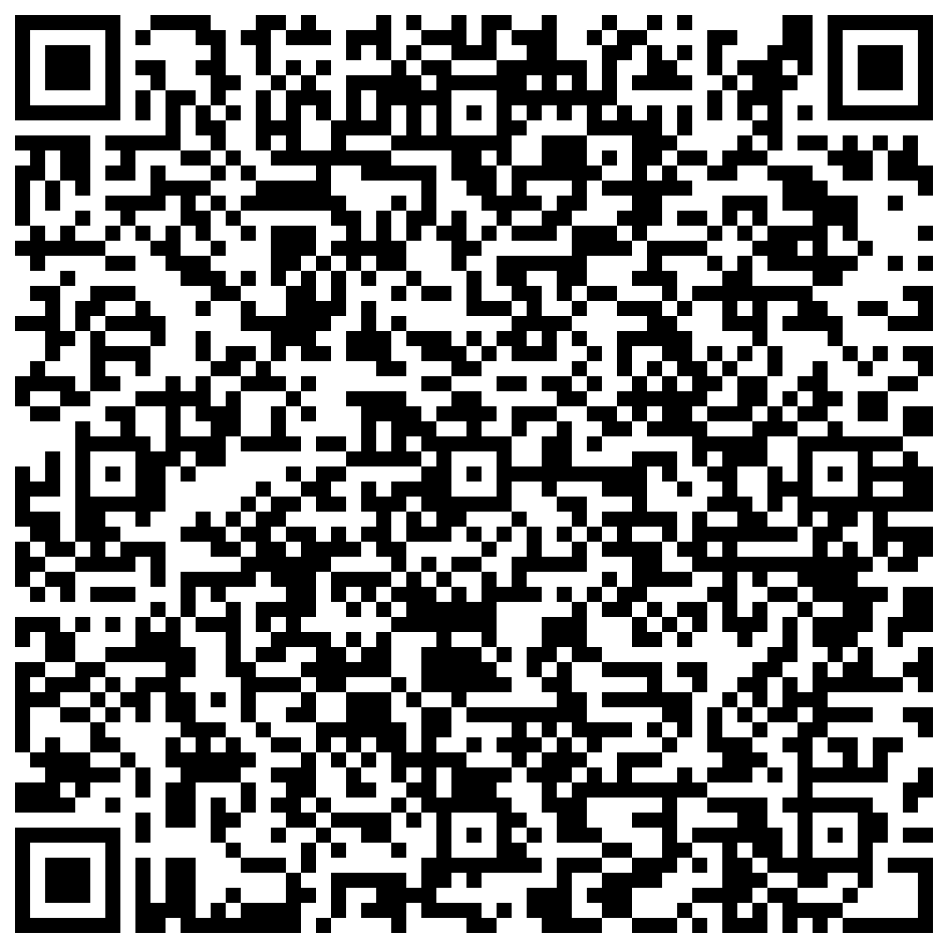

Application
Closing date: 13 Nov 2025
Please email your letter of nomination/support from your employers/school leaders to shafiqah.raihan@nie.edu.sg.

Slide 9
FAQ
Is the MOE sponsorship on first-come-first-serve basis?
  No, it isn’t. We will review the applications (including the write-up) in making the selection. We will also ensure equitable distribution of opportunities across schools.
My school is an autonomous/independent school. Am I eligible for the MOE sponsorship?
  The sponsorship is for MOE schools (including autonomous), HQ officers and AST officers. Alternative funding include school’s PD funds and self-funding.
If I register for this Programme, how do I attend lessons in the afternoons on weekdays?
  Alternative arrangements will have to be made at the school level. The Principals’ letter of support as indication of commitment to the teacher’s PD growth is important in this context.

Slide 10
FAQ
4. What happens if the sponsored teacher cannot cope halfway and ask to withdraw from the course? Will there be any penalty?
5. What is the penalty for me if I am sponsored by MOE and cannot complete the programme?
  Cases of teachers being unable to complete certification courses would likely be rare as these teachers would have made a commitment and sought support from their school before embarking on the certification.
  If there are such cases, MOE will review on a case-by-case basis (ideally in their 4th year for sufficient lead time for engagement).
The teacher has attended >30% of the course duration | A “W” grade will be awarded. Required to pay full course fee.
The teacher has attended <30% of the course duration | A “W” grade will be awarded. Not required to pay full course fee.

Slide 11
FAQ
5. Can I take the courses as stand-alone in service course?
  Yes. However, we have a quota of 30pax for each cycle. Registration for inservice is open after we have confirmed the Programme participants.
6. What if I am not sure if I can commit to completing the Programme?
  Consider taking the courses as stand-alone course and stack them toward a Certification programme within 5 years.

Slide 12
Certificate in
STEM Curriculum Development Programme
© 2022 Nanyang Technological University, Singapore. All Rights Reserved.

